Slide 1
Mexico’s Facts Contest
Área Académica: Licenciatura en Ingeniería Industrial
Profesor(a): L.E.L.I Leticia Sánchez Franco
Periodo: Julio- Diciembre 2015

Slide 2

Resumen
El siguiente ejercicio tiene como objetivo promover conocimientos culturales y geográficos de nuestro país, a través de preguntas y respuestas utilizando la estructura gramatical de presente simple.
Abstract
The following activity was designed to promote cultural and geographical knowledge of our country by responding to a series of questions. The simple present structure is used in this activity.
Key words: country, region, eat, produce, drink, wear, traditional, typical.

Slide 3
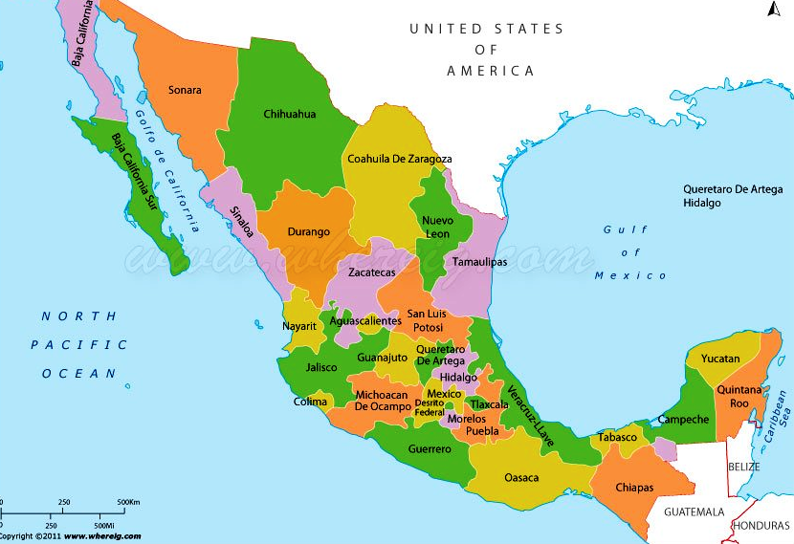

Slide 4
MEXICO’S FACTS
CONTEST
1
2
3
4
5
6
7
8
9
10
11
12

Slide 5
MEXICO’S FACTS
CONTEST
What do people eat in Nuevo Leon?
They eat Cabrito.

Slide 6

MEXICO’S FACTS
CONTEST
Where do people speak náhuatl in Mexico?
In Hidalgo, Puebla, Veracruz.

Slide 7
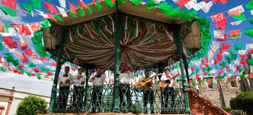
MEXICO’S FACTS
CONTEST
Do people drink mezcal in Jalisco?
No, they don’t. They drink tequila.

Slide 8
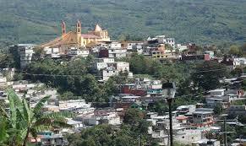
MEXICO’S FACTS
CONTEST
What do women wear in Chiapas?
They wear traditional clothes.

Slide 9
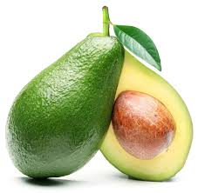
MEXICO’S FACTS
CONTEST
Where do people produce avocado?
They produce avocado in Michoacan.

Slide 10
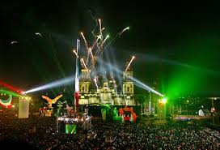
MEXICO’S FACTS
CONTEST
When do Mexicans celebrate the Independence Day?
They celebrate it on September 16th.

Slide 11
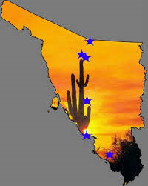
MEXICO’S FACTS
CONTEST
Does Sonora have typical food?
Yes, it does.
People eat burritos and
grilled meat.

Slide 12
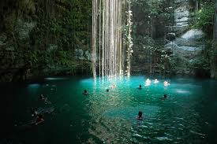
MEXICO’S FACTS
CONTEST
What’s the capital of Yucatan?
It is Merida.

Slide 13
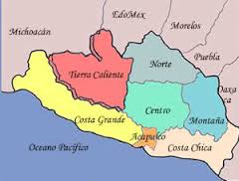
MEXICO’S FACTS
CONTEST
What does Guerrero produce?
The region produces mangoes, corn and fish.

Slide 14
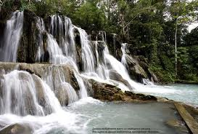
MEXICO’S FACTS
CONTEST
What’s the weather like in Tabasco?
It’s very hot and humid.

Slide 15
MEXICO’S FACTS
CONTEST
Do some men wear a Mariachi suit in Tlaxcala?
No, they don’t. Some men
wear short pants, a vest
and a cape.

Slide 16
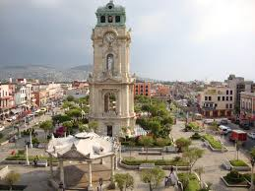
MEXICO’S FACTS
CONTEST
Does Hidalgo have a famous drink?
Yes, it does. People drink pulque.

Slide 17
MEXICO’S FACTS
CONTEST
ACTIVITY
Design five questions about different states of Mexico.
Then practice with a partner

